Slide 1

Machine Learning Project
Team:
Assem, Madina, Umit

Slide 2

IDEA
Identifying whether product should be recommended

Slide 3
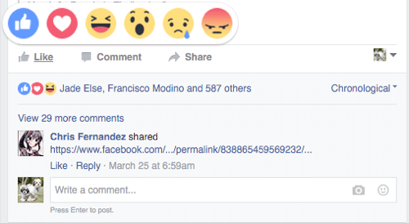
Input data (X)
ID;
Name;
Rating;
Comment.

Slide 4

Output data (Y)
Identifies the sentiment of recommendation. Positive, neutral, negative and so on…

Slide 5
Example of dataset
ID | Name | Rating | Comment
1 | Eminem - Lose Yourself | 10 | Great. Just as good as described
2 | David Guetta - Titanium | 8 | Love it
3 | IFR - You took a sample of my PASTA | 4 | I really disappointed

